Slide 1
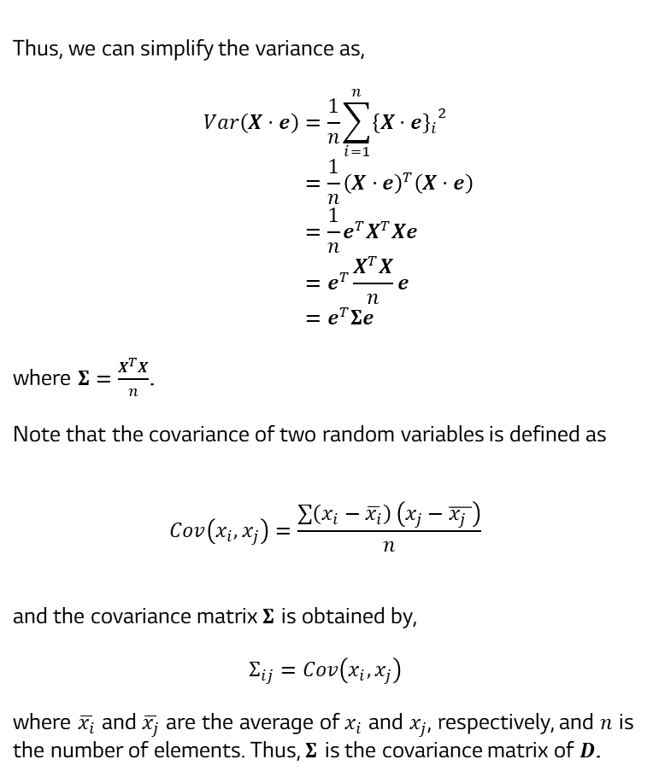
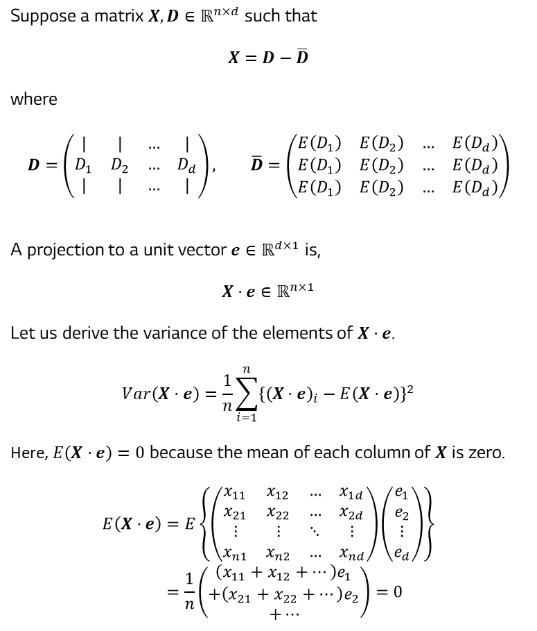
Geometric (Lens) Calibration
알고리즘 설명
Suppose a matrix $X,D∈ℝ^{n×d}$ such that
$$X=D−\overline{D}$$
where
$$D=\left(\begin{matrix}| & | & … & | \\ D_{1} & D_{2} & … & D_{d} \\ | & | & … & |\end{matrix}\right), \overline{D}=\left(\begin{matrix}E\left(D_{1}\right) & E\left(D_{2}\right) & … & E\left(D_{d}\right) \\ E\left(D_{1}\right) & E\left(D_{2}\right) & … & E\left(D_{d}\right) \\ E\left(D_{1}\right) & E\left(D_{2}\right) & … & E\left(D_{d}\right)\end{matrix}\right)$$
A projection to a unit vector $e∈ℝ^{d×1}$ is,
$$X⋅e∈ℝ^{n×1}$$
Let us derive the variance of the elements of $X⋅e$.
$$Var\left(X⋅e\right)=\frac{1}{n}\sum_{i=1}^{n}{{\left\{{\left(X⋅e\right)}_{i}−E\left(X⋅e\right)\right\}}^{2}}$$
Here, $E\left(X⋅e\right)=0$ because the mean of each column of $X$ is zero.
$$E\left(X⋅e\right)=E\left\{\left(\begin{matrix}x_{11} & x_{12} & … & x_{1d} \\ x_{21} & x_{22} & … & x_{2d} \\ ⋮ & ⋮ & ⋱ & ⋮ \\ x_{n1} & x_{n2} & … & x_{nd}\end{matrix}\right)\left(\begin{matrix}e_{1} \\ e_{2} \\ ⋮ \\ e_{d}\end{matrix}\right)\right\} \\ =\frac{1}{n}\left(\begin{matrix}\left(x_{11}+x_{12}+…\right)e_{1} \\ +\left(x_{21}+x_{22}+…\right)e_{2} \\ +…\end{matrix}\right)=0$$
Thus, we can simplify the variance as,
$$Var\left(X⋅e\right)=\frac{1}{n}\sum_{i=1}^{n}{{{\left\{X⋅e\right\}}_{i}}^{2}} \\ =\frac{1}{n}{\left(X⋅e\right)}^{T}\left(X⋅e\right) \\ =\frac{1}{n}e^{T}X^{T}Xe \\ =e^{T}\frac{X^{T}X}{n}e \\ =e^{T}Σe$$
where $Σ=\frac{X^{T}X}{n}$.
Note that the covariance of two random variables is defined as
$$Cov\left(x_{i},x_{j}\right)=\frac{\sum{\left(x_{i}−\overline{x_{i}}\right)}\left(x_{j}−\overline{x_{j} }\right)}{n}$$
and the covariance matrix $Σ$ is obtained by,
$$Σ_{ij}=Cov\left(x_{i},x_{j}\right)$$
where $\overline{x_{i}}$ and $\overline{x_{j}}$ are the average of $x_{i}$ and $x_{j}$, respectively, and $n$ is the number of elements. Thus, $Σ$ is the covariance matrix of $D$.

Slide 2
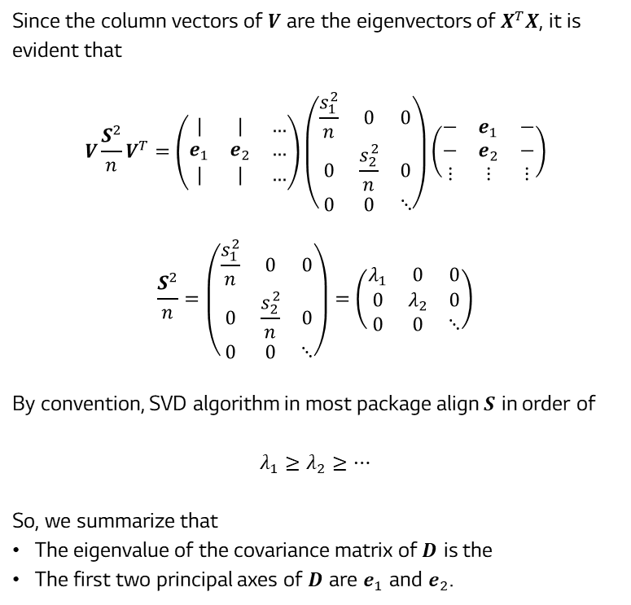
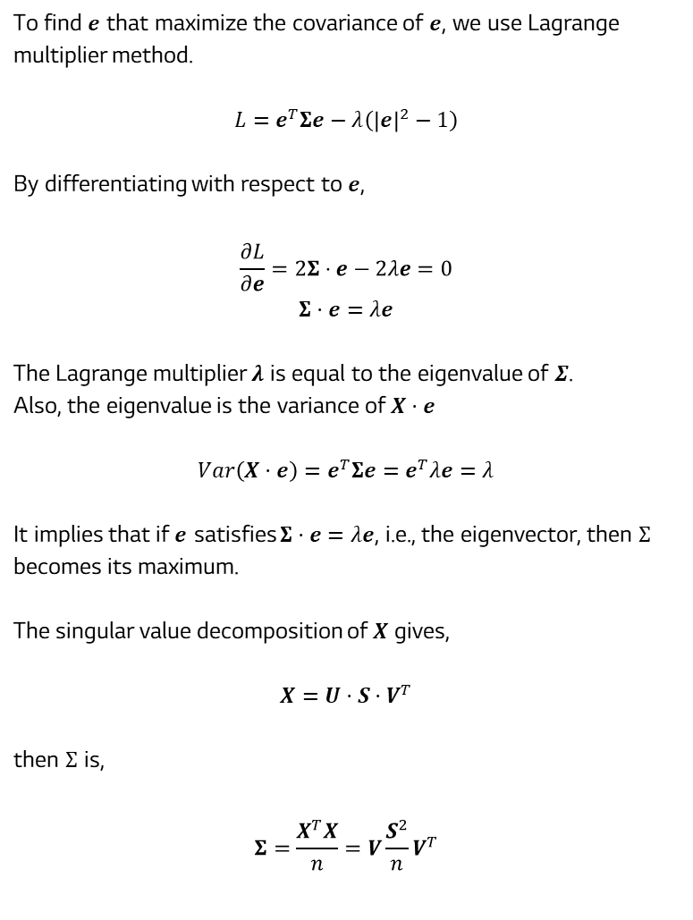
Geometric (Lens) Calibration
알고리즘 설명
To find $e$ that maximize the covariance of $e$, we use Lagrange multiplier method.
$$L=e^{T}Σe−λ\left({\left|e\right|}^{2}−1\right)$$
By differentiating with respect to $e$,
$$\frac{∂L}{∂e}=2Σ⋅e−2λe=0$$
$$Σ⋅e=λe$$
The Lagrange multiplier $λ$ is equal to the eigenvalue of $Σ$.
Also, the eigenvalue is the variance of $X⋅e$
$$Var\left(X⋅e\right)=e^{T}Σe=e^{T}λe=λ$$
It implies that if $e$ satisfies $Σ⋅e=λe$, i.e., the eigenvector, then $Σ$ becomes its maximum.
The singular value decomposition of $X$ gives,
$$X=U⋅S⋅V^{T}$$
then $Σ$ is,
$$Σ=\frac{X^{T}X}{n}=V\frac{S^{2}}{n}V^{T}$$
Since the column vectors of $V$ are the eigenvectors of $X^{T}X$, it is evident that
$$V\frac{S^{2}}{n}V^{T}=\left(\begin{matrix}| & | & … \\ e_{1} & e_{2} & … \\ | & | & …\end{matrix}\right)\left(\begin{matrix}\frac{s_{1}^{2}}{n} & 0 & 0 \\ 0 & \frac{s_{2}^{2}}{n} & 0 \\ 0 & 0 & ⋱\end{matrix}\right)\left(\begin{matrix}− & e_{1} & − \\ − & e_{2} & − \\ ⋮ & ⋮ & ⋮\end{matrix}\right)$$
$$\frac{S^{2}}{n}=\left(\begin{matrix}\frac{s_{1}^{2}}{n} & 0 & 0 \\ 0 & \frac{s_{2}^{2}}{n} & 0 \\ 0 & 0 & ⋱\end{matrix}\right)=\left(\begin{matrix}λ_{1} & 0 & 0 \\ 0 & λ_{2} & 0 \\ 0 & 0 & ⋱\end{matrix}\right)$$
By convention, SVD algorithm in most package align $S$ in order of
$$λ_{1}≥λ_{2}≥…$$
So, we summarize that
The eigenvalue of the covariance matrix of $D$ is the
The first two principal axes of $D$ are $e_{1}$ and $e_{2}$.

